Slide 1

Cyber 101: Linux Crash Course
ANDREW SCIANDRA
COMPUTER SCIENCE MAJOR, 2020

Slide 2
About Me
I am a sophomore majoring in Computer Science and possibly minoring in History
I’ve been going to the Cyber Dawgs meetings for over a year now
I am unofficially on the Board for the Cyber Dawgs Club (I’m heading up the social media….follow us @UMBCCyberDawgs
Some of my interest in Cyber Security are Recon and Offensive Security but it all is really cool.

Slide 3
What will we be covering in this presentation?
The basics of operating in and using Linux/the command line
File/directory navigation & management
Users, Groups, and Permissions
Working with a simple text editor
The Linux directory structure

Slide 4

So…what is Linux?
An open source operating system based off of UNIX
Developed by Linus Torvalds in 1991
Several different ‘flavors’ of Linux exist…
Red Hat/Enterprise
Fedora
Ubuntu
Debian
CentOS

Slide 5
Uhhh excuse me I like Windows or Mac OS X. Why would I use Linux (or a command line interface)?
Windows and Mac OS X have their merits for things like compatibility and familiarity, but…
Linux is FREE, so lots of businesses use it
It’s an extremely efficient OS, and each distro gets a lot of revisions
In terms of specifications, it’s very resource friendly!
For command line interfaces, it’s all about interfacing…
GUIs (Graphical User Interfaces) are nice-to-haves in the working world
It’s also a nice skill to have!

Slide 6
Still not convinced on Linux???
Linux will run on just about any computer
You can customize the installation to fit most hardware around today
You can personally update Linux from the command line
Linux is extremely customizable and is a great way for beginners to learn new skills and how to navigate a very widely used tool
Since it is very widely used in industry it is a great resume builder that companies will take note of
Compilers for widely used languages (C, C++) are included and intepreters for Python, PHP, and more are included too

Slide 7
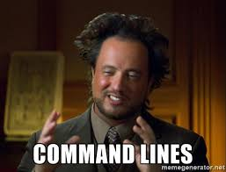
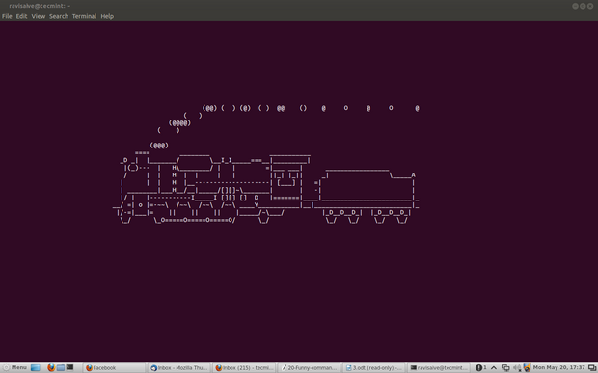

Okay so now I’ve got you hooked on Linux but now you’re wondering what a command line interface is…
A non-graphical user interface for a computer’s operating system
Basically, it lets you talk to your computer in a text-based environment.
A lot of (if not all) OSs have something like this!
In Linux or Mac OS X, this is referred to as the ‘terminal’
In Windows, this is called the ‘Command Prompt’

Slide 8

Okay, so I can command prompt now…but now what?
YOU CAN DO SO MANY AMAZING THINGS!!!
What we’ll be going over now are some useful commands that will prepare you for the rest of the week in using your Linux environment!
Don’t be afraid to ask questions!

Slide 9
THE MOST IMPORTANT COMMAND OF THEM ALL
The ‘man’ command, this will be your go to command. Its short for manual
Used to list and display command manual pages
Usage example 1 (UE1): ‘man man’ (yes, man has its own man page)
UE2: ‘man ls’
EVERY COMMAND HAS THIS. If you forget how to use a command or want to know if it can do something, use this!

Slide 10
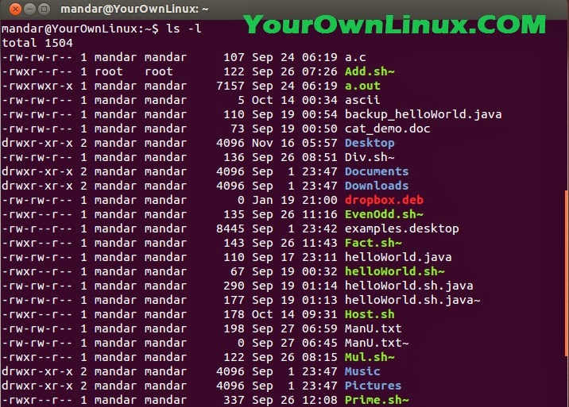
Moving on to directory navigation commands…
The ‘ls’ command
Stands for list directory
Lists all of the current directory contents!
UE1: ls
UE2: ls -l
UE3: ls -la
Wait a sec…what are those dash letter things at the end?
A quick talk about flags!!

Slide 11
HERE COME THE COMMANDS!
cd (stands for ‘change directory’): lets you change directories
UE: cd /home/<your username>
Special characters: ~, ., .., /
pwd (stands for ‘print working drectory’): lets you know where you are!
A lot more useful than it sounds!!
mkdir (make directory): lets you make a directory (or ‘folder’)
UE1: mkdir test_dir1
UE2: mkdir test_dir2 test_dir3
touch: a quick way to make an empty file
UE: touch test_file1.txt test_file2.txt
Also, if you ever want to STOP a command or process, use ctrl+c

Slide 12
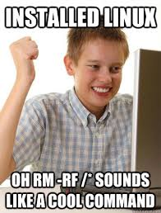
Moving, renaming, and removing
cp (stands for copy!)
UE1: cp test_file1.txt ~/test_dir1
UE2: cp test_file1.txt ..
mv (stands for move)
Like cp, but more like ‘cut’
UE1: mv test_file1.txt ~/test_dir2
You can also rename files like this!
UE2: mv test_file2.txt home_file.txt
TAB COMPLETION: IT’S AWESOME
rm (stands for remove)
Used to remove both files AND directories!
UE1: rm test_file1.txt
UE2: rm -r test_dir3
UE3: rm -rf test_dir2
UE4 (DO NOT RUN THIS COMMAND)
rm –rf test_dir1 /*
Can anyone tell me what that asterisk is?

Slide 13
The Star Wildcard and the Pipe Operator
The * is used to represent every string
You can use it to find, delete, etc. for files with a certain extensions
Ex: *.py / *.html / *.jpg / and much more
But BE CAREFUL!! The asterisk can also be used to DELETE all of your files so if you are using rm and * be sure your command is correct pressing enter!
The Pipe Operator ( | ) is used as a form of redirection
It will send the output from the first command to the next command after the pipe
Command One | Command Two | Command Three
History | grep vim

Slide 14

Output commands
echo: writes arguments to standard out
UE1: echo Hello everybody!
This can also be used to let you know stuff that’s in your directory!
UE2: echo t*
cat (no, not like the animal!): Prints out file contents
UE1: cat test_file1.txt
less: like cat, but lets you scroll up and down
UE1: less test_file1.txt
UE2: man ls | less

Slide 15


Other Cool and Useful Commands
ctrl-l: Clears the screen
ctrl-c: Kills the program that is running and returns control to the user
grep: one of the methods used to search for files in the linux file system
whoami: prints the user name out to the screen
find: another method to search for files

Slide 16
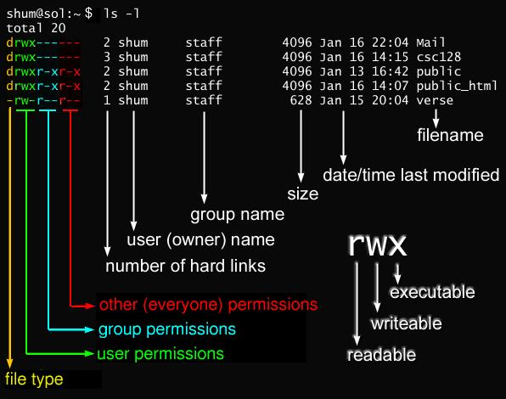
Now then, permissions…

Slide 17
Useful permissions commands
sudo: run a command as an administrative user
Some commands REQUIRE this. Other situations may relate back to permissions on the file/directory/user
UE1: sudo su
chmod: lets you change the permissions on a file or directory
MUST BE RUN AS SUDO
UE1: sudo chmod 777 test_dir1 ← THIS IS A BAD IDEA
UE2: sudo chmod 000 test_file1.txt ← NO ONE CAN ACCESS THIS (except for admins)
4 = read, 2 = write, 1 = execute
REGULAR FILES = 644, DIRECTORIES AND EXECUTABLE FILES = 755

Slide 18
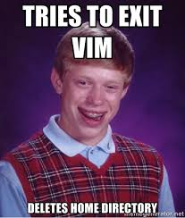
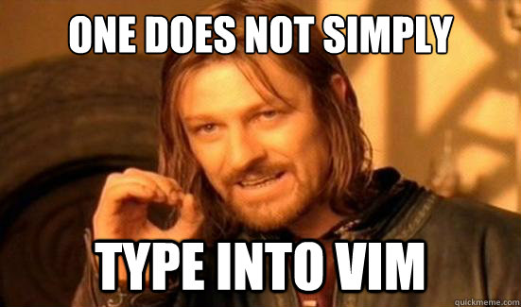
VI / VIM (Side Note: VIM > EMACS)
Comes with pretty much every distro of Linux
Very simple to use at a basic level, but has a LOT of depth to it if you want to get super good at it.
Open up your text file: vim test_file1.txt

Slide 19
The Basic Vim cheat sheet!
To type in vim, enter insert mode by hitting the ‘i’ key
Exit out of this by hitting ‘esc’
To shift into copy/cut/paste mode, enter visual mode by hitting the ‘v’ key
While in visual, you can use the keyboard to select lines of text!
You can copy a line of text by hitting the ‘y’ key in visual mode
You can paste by hitting the ‘p’ key
You can also cut using the ‘d’ key
To save and/or quit after editing, use the command mod (all commands start with ‘:’)
:w = save
:q = quit
:wq = save and quit
:w! = force write
:q! = force quit

Slide 20
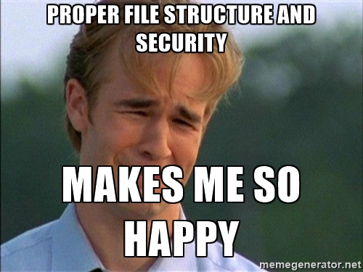
Now, let’s talk about the Linux Directory Structure!
If you do a cd / and an ls in there, you’ll see a bunch of directories in there.
Note: Directories are in blue, files are white!
Each of these directories hold a lot of important information, and are organized in a certain way!
So here’s what you need to know…

Slide 21
Linux Directory Structure Goodies
home: home directories for all users
root: home directory for the root user (DO NOT MESS WITH THIS)
bin: Common single user linux commands/binaries
You’ll notice lots of yellow files in here…what does that mean?
etc: Configuration files + startup/shutdown scripts
var: ‘variable’ files, or files that are expected to grow in size
Database files (var/lib), log files (var/log)
boot: Boot loader files (kernel files)
usr: User programs for ‘second level’ programs
usr/bin: usually where you look if the command you’re running isn’t inside of /bin
proc: System process information

Slide 22

A few final-but important-commands
Updating and installing on your system: package managers
Different on a lot of distros
CentOS uses yum, Ubuntu uses apt, Fedora uses dnf.
<package manager> update
<package manager> install <package name>
Archive + Compression: tar
tar czvf <name of file> <directory to compress>
tar xzvf <name of archive file>
You may also run into zip or bzip2 files – use your man pages!!!

Slide 23
Searching files and directories
Looking for a particular named file/directory? Use the find command.
find <directory to search> -name “<name of file/directory>”
find <directory to search> -type f -name “<name of file>”
Find has lots of cool options associated with it-MAN!!!
Need to look through your files to see if there’s a certain word? Use the grep command! (I really like this command)
grep -i “<string in file>” <file name>
grep -rni “<string in file>” <directory/to/search>

Slide 24
SSH
Secure SHell (SSH)
Allows you to remotely log into another system/server
When you’re logging in to GL you are SSH’ing into UMBC Server
ssh –l <username> <destination>

Slide 25
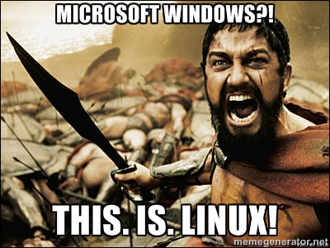
AND NOW YOU CAN DO STUFF IN LINUX!!!
If you have any questions, I know lots of stuff about Linux, so just come and ask!
THANK YOU FOR LISTENING!!!

Slide 26
Hand—On Activity
Bandit:
http://overthewire.org/wargames/bandit/bandit0.html
Putty:
https://www.chiark.greenend.org.uk/~sgtatham/putty/latest.html

